Slide 1
Individual Meeting
Jason Chang

Slide 2
Outline
TSMC
time_series_tools – forecasting with darts
GoEdge.ai
time_series_tools – (early) segmentation with tslib
Own Paper
LLM4TS (submitted to TIST 2024)
I’ll submit it within two weeks.
Future Papers
PromptTSS (target: AAAI 2025 ICLR 2025)
TimeDRL-semi (target: TKDD or TNNLS)

Slide 3
Before we start
TSMC合作
目前五個專案
D2 TAM: 尚未有時間進行資料分析，有請Ling幫忙把model 1 2 3理解完，看能不能用darts來implement
D2 PLC: 單純顧問，還沒有太多的workload
SPID SPI: 主要進度追蹤者，目前darts的工具主要是match這邊的需求
C1: 次要進度追蹤者，希望看到feature importance
C2: 新進專案，Dr. Chen認為的重心
UCLA交換
已經送出千里馬申請，預計11月底放榜
會盡量催DS2019的進度，因為要入境 (J-1是非移民簽證)才可以送出綠卡申請
需要與Wei Wang告知實習意願嗎? J-1需要註明才可以在UCLA的那段時間實習
如果是在台灣的TSMC遠端實習，確實不一定要讓Wei Wang知道
不過我還是想要嘗試看看美國的實習機會 (ex: Google Research PhD Intern)

Slide 4
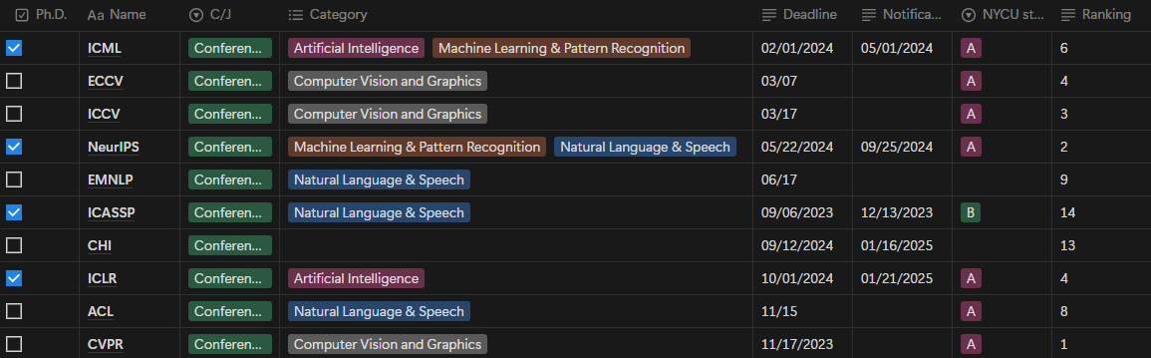
Google Research’s top conference

Slide 5
TSMC

Slide 6
GoEdge.ai

Slide 7
Own Paper

Slide 8
Publication Lists (First Author)
TimeDRL (ICDE 2024 accepted)
LLM4TS (TIST 2024 submitted)
PromptTSS (target: ICLR 2025)
TimeDRL-semi (only 25% difference)
Q1 journal (after ICDE acceptance)
TIST, TNNLS, TKDD, TPAMI
After the third paper
TSMC paper
UCLA paper

Slide 9
PromptTSS
Ching Chang

Slide 10
Why promptable?
Leverage more information in the inference stage
Mult-level granularity

Slide 11
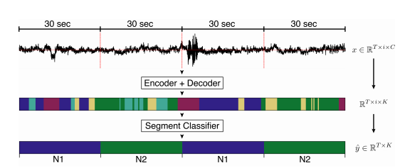
Multiple Granularity of Time-Series Segmentation
Prompt:
Class
Point
Level 1
Level 2
Level 2
Promptable
Design
Level 2
Requirements:
When training, we can leverage multi-granularity labels
When inference, we can give no prompts
Level 1
input
output

Slide 12
Experiments
Datasets
Evaluation Metrics
Baselines

Slide 13
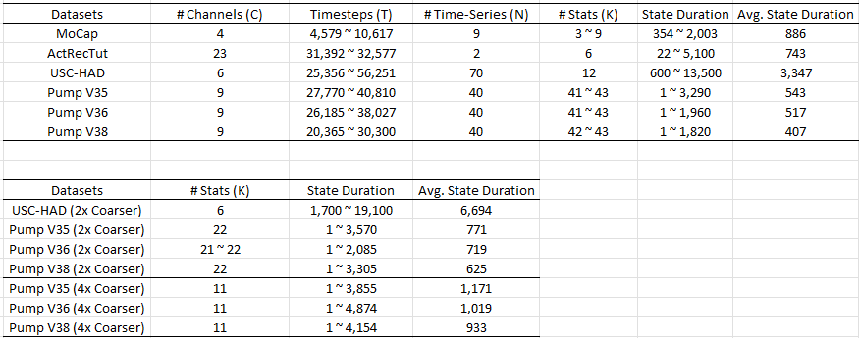
Datasets

Slide 14
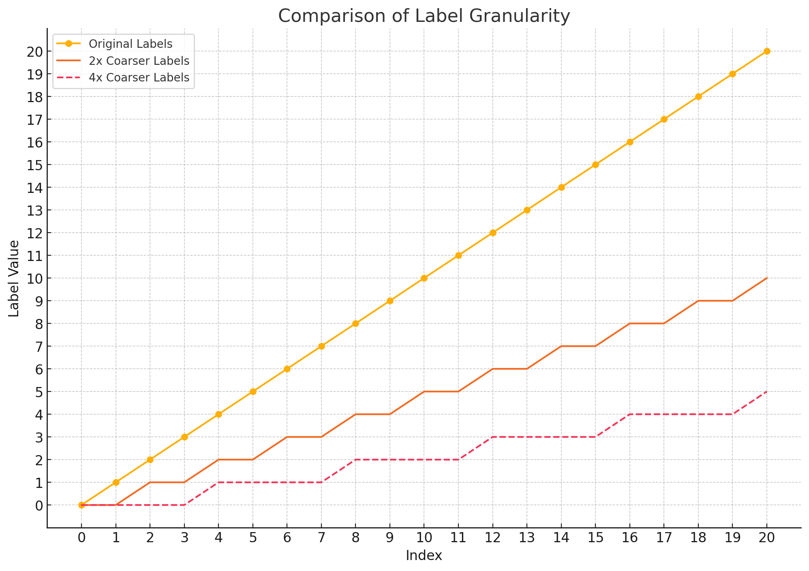
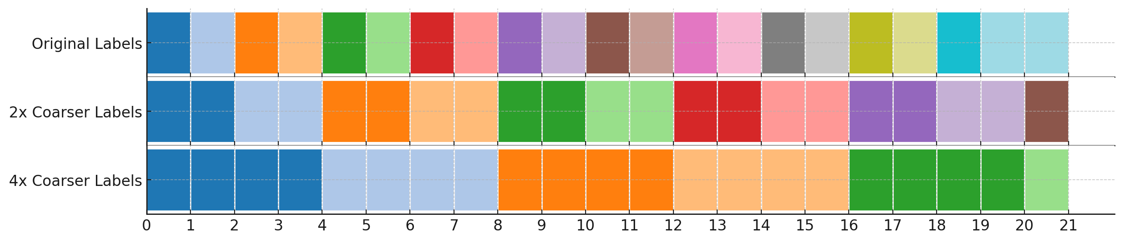
Multiple Granularity
How to change from high granularity to low granularity: merge!

Slide 15
Input and Output
Time-Series
Granularity
Information
Labels

Slide 16
Evaluation Metrics
Segmentation (often used in supervised)
Accuracy
MF1 (Macro F1)
Kappa
Clustering (often used in unsupervised)
ARI
NMI

Slide 17
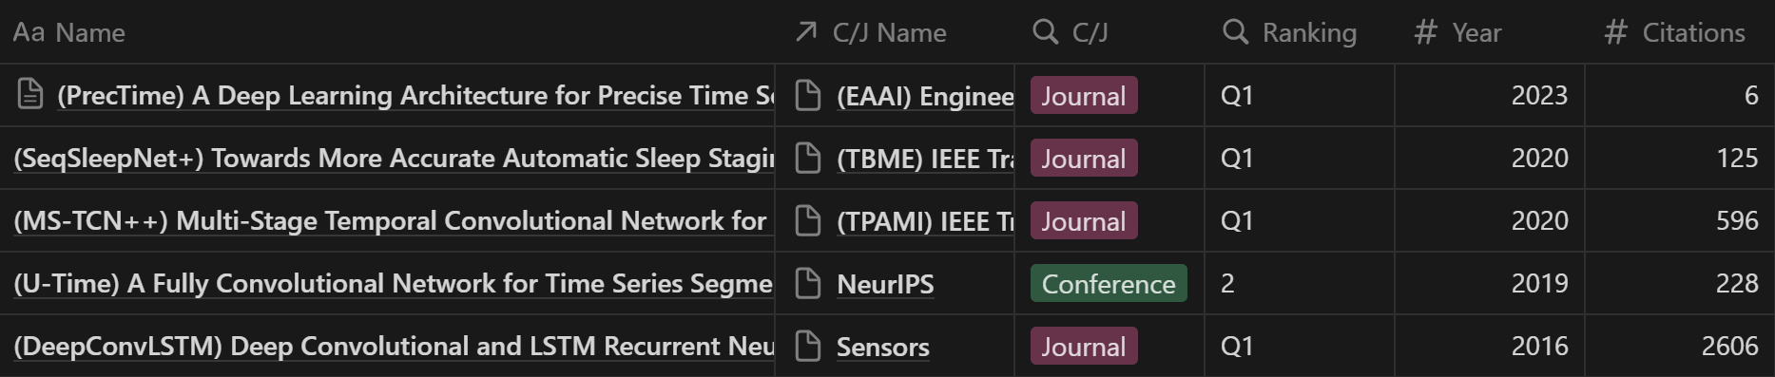
Baselines
Supervised

Slide 18
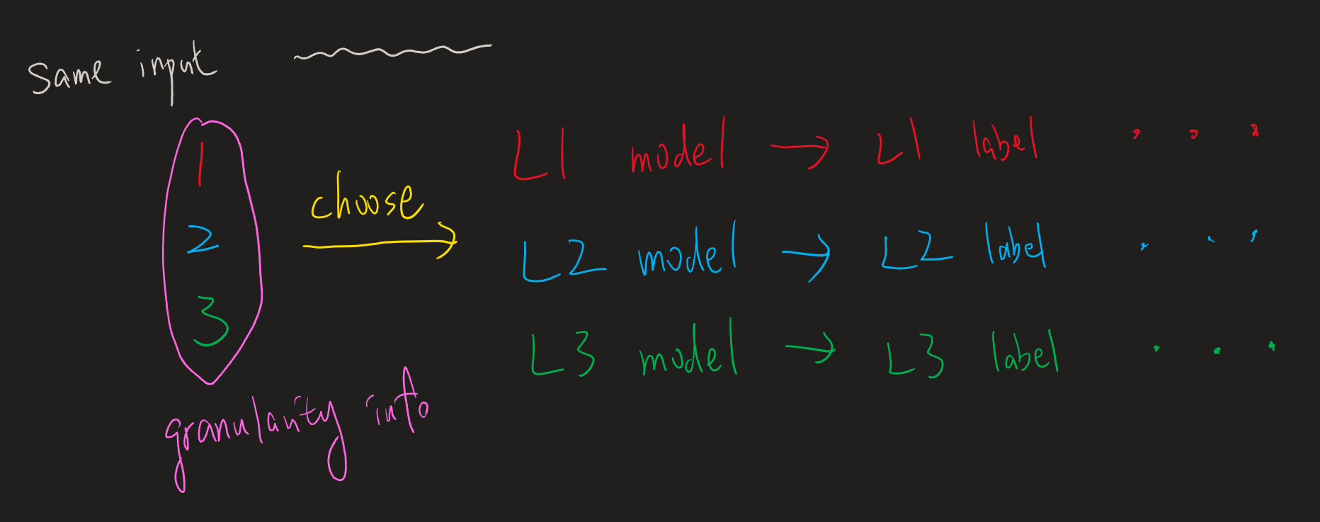
How to make baselines support multiple-granularity?

Slide 19
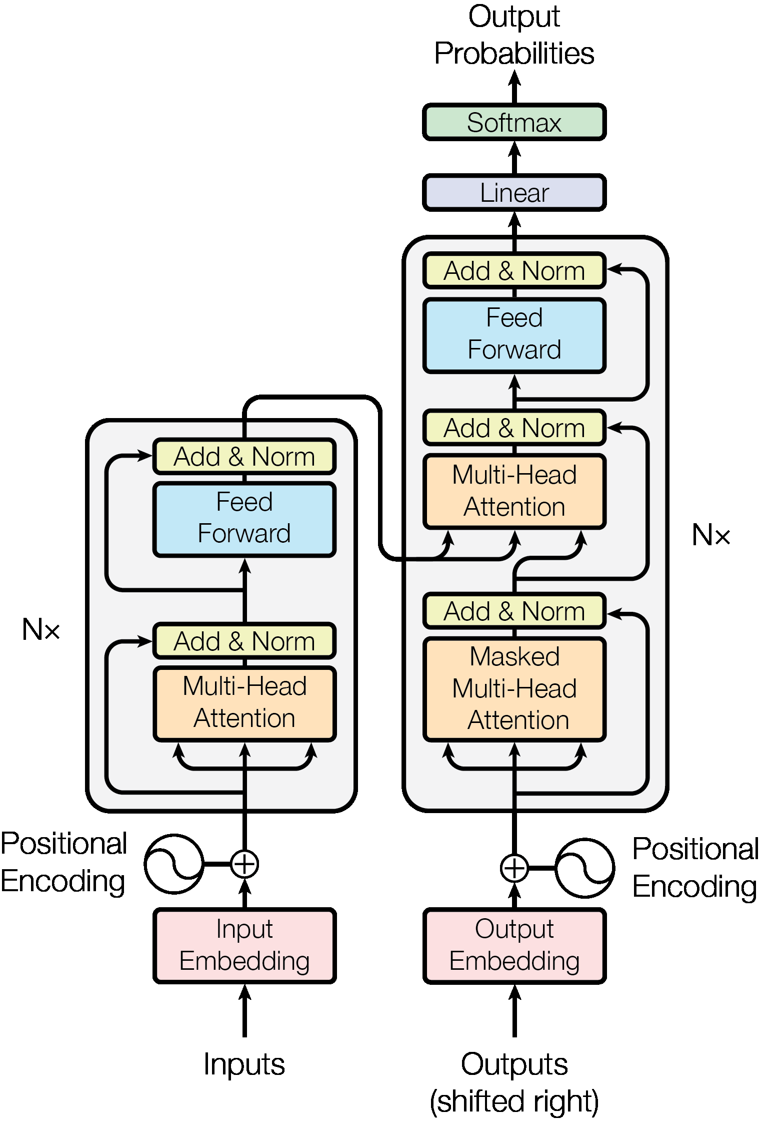
SAM v.s. PromptTSS
Segmentation
GPU
CPU
Final Mask
Image encoder
Mask decoder
Embedding
Prompt encoder
Multi-Head
Attention
Image
Prompt
Time-Series Input Layer
Prompt
Input Layer
Time-Series
Prompts

Slide 20
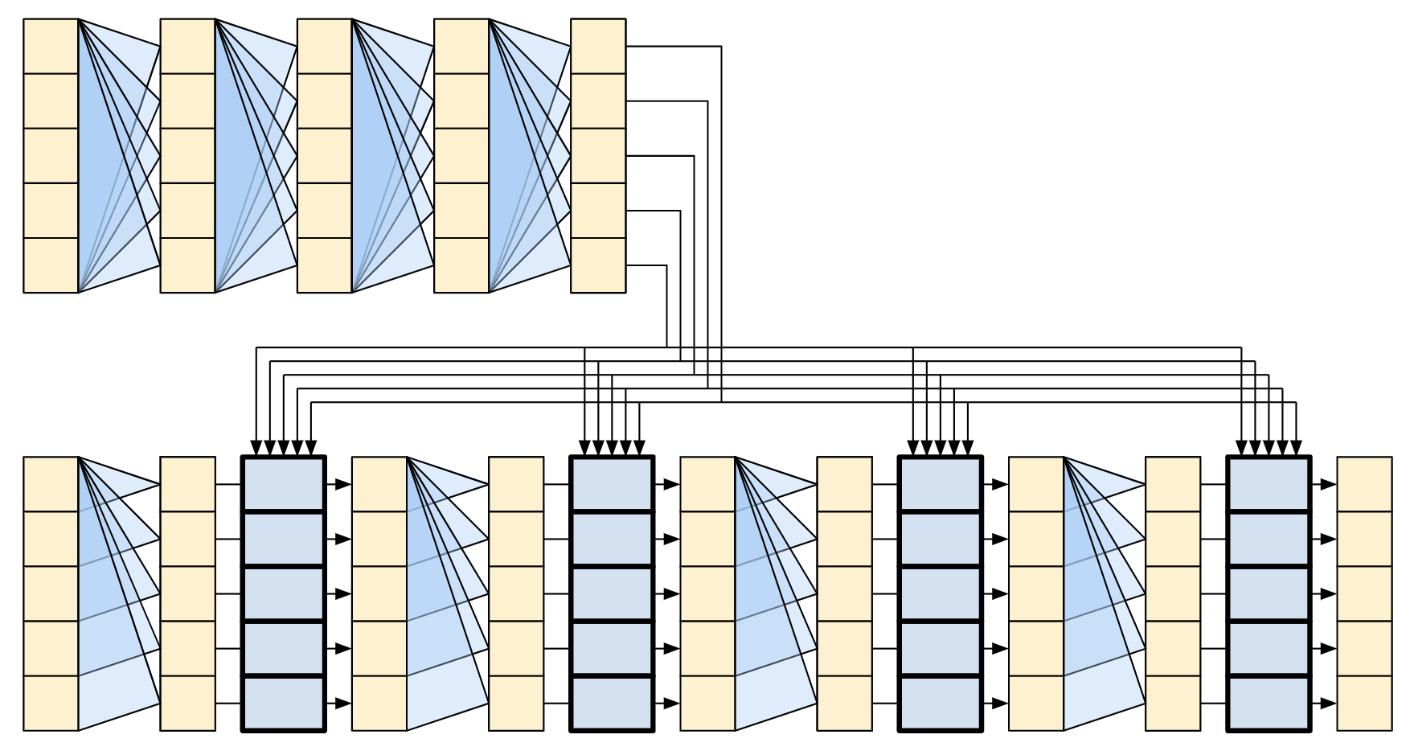
PromptTSS (w/o Patching)
Transformer
Encoder
Time-Series
(B, T_{in} , C)
(B, T_{in} , C)
(B, T_{in}, D)
(B, T_{in}, D)
Instance Normalization
(w/o affine)
Time-Series
Input Layer
(B, T_{in} )
(B, T_{in} , D)
Prompt
nn.Embedding(K, D)
Prompt
Input Layer
Transformer
Decoder
(B, T_{in} , D)
Output Layer
1. Dropout
2. Linear (B, T_{in}, K)
(B, T_{in}, K)

Slide 21
PromptTSS (w/ Patching)
Transformer
Encoder
Time-Series
(B, T_{in} , C)
(B, T_{in} , C_{t})
(B, T_{p}, C_{t}*P)
(B, T_{p}, D)
(B, T_{p}, D)
Instance Normalization
(w/o affine)
Patching
Time-Series
Input Layer
(B, T_{in} )
(B, T_{in} , C_{p})
(B, T_{p} , C_{p}*P)
(B, T_{p} , D)
Prompt
nn.Embedding(K, C_{p})
Patching
Prompt
Input Layer
Transformer
Decoder
(B, T_{p} , D)
Output Layer
1. Rearrange (B, T_{p}*D)
2. Dropout
3. Linear (B, T_{in}*K)
4. Rearrange (B, T_{in}, K)
(B, T_{in}, K)

Slide 22
PromptTSS (w/ Patching)
Transformer
Encoder
Time-Series
(B, T_{in} , C)
(B, T_{in} , C_{t})
(B, T_{p}, C_{t}*P)
(B, T_{p}, D)
(B, T_{p}, D)
Instance Normalization
(w/o affine)
Patching
Time-Series
Input Layer
Granularity level embedding
(B, T_{in} )
(B, T_{in} , C_{p})
(B, T_{p} , C_{p}*P)
(B, T_{p} , D)
Prompt
nn.Embedding(K, C_{p})
Patching
Prompt
Input Layer
Predicted
labels
Transformer
Decoder
(B, T_{p} , D)
Output Layer
1. Rearrange (B, T_{p}*D)
2. Dropout
3. Linear (B, T_{in}*K)
4. Rearrange (B, T_{in}, K)
(B, T_{in}, K)

Slide 23
Experiments
Please see the csv file

Slide 24
Thanks for your attention

